Slide 1
AVL Tree
Session 20
Anang Prasetyo, S.Kom., M.Kom.

Slide 2
Learning outcomes
At the end of this session, students will be able to:
LO 1: Explain the concept of data structures and its usage in Computer Science
LO 2: Illustrate any learned data structure and its usage in application
LO 3: Apply data structures using C

Slide 3
Subtopics
Balanced Binary Search Tree
AVL Concept & Application
AVL Operations & Rebalancing

Slide 4
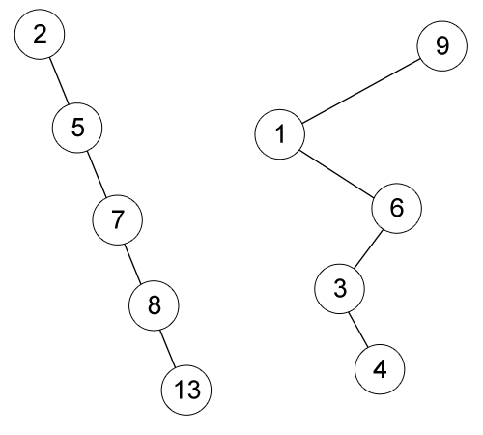
BALANCED BINARY SEARCH TREE
Binary Search Tree Review
Example of skewed Binary Search Tree
The left BST is inserted by 2, 5, 7, 8 and 13 respectively.
The right BST is inserted by 9, 1, 6, 3 and 4 respectively.

Slide 5
BALANCED BINARY SEARCH TREE
We want a tree with small height.
What is the minimal height of a BST with N nodes?
θ(log n)
Our goal is to keep the height of a BST to be O(log n)
Such trees are called Balanced Binary Search Tree (i.e. AVL Tree, Red Black Tree)

Slide 6
AVL concept and application
AVL Tree is named after its two inventors, G.M. Adelson-Veleskii and E.M. Landis.​
AVL Tree is the first self-balancing binary search tree invented which each node maintains extra information called a balance factor whose value is either -1, 0 or +1​

Slide 7
AVL concept and application
Height of a node:​
The height of an empty subtree is 0.​
The height of a leaf is 1.​
The height of an internal node is the maximum height of its children plus 1.​
Balance factor:​
The difference height of its LEFT subtree and its RIGHT subtree.​
The balance factor of all nodes in AVL tree should be at most 1.​

Slide 8
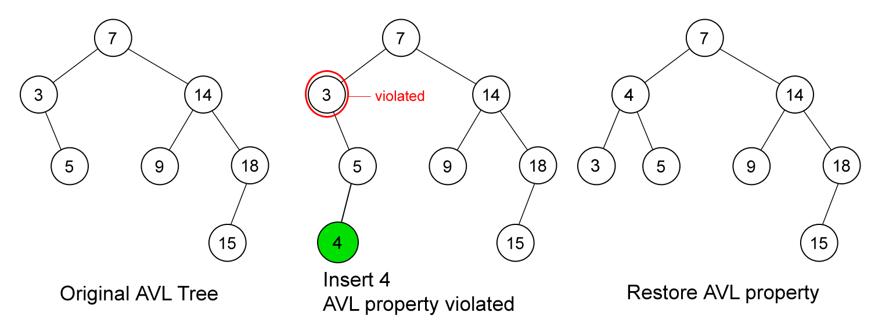
AVL operations and rebalancing
Operation INSERTION
First, insert the new key as a new leaf just as in ordinary Binary Search Tree insert strategy.
But this may cause violation of AVL Tree property.
Next, restore the balance condition.

Slide 9
AVL operations and rebalancing
Rebalance AVL Tree
After an insertion, only nodes that are on the path from the inserted node to the root that might violate the AVL property.
Why?
Rebalance the tree at the deepest level of such nodes guarantees that the property of AVL Tree restored.
Why?
How to rebalance a violated AVL Tree?

Slide 10
AVL operations and rebalancing
Rebalance AVL Tree
Let the node that must be rebalanced be T.
There is 4 cases:
Case 1 : the deepest node is located at the left sub tree of the left child of T.
Case 2 : the deepest node is located at the right sub tree of the right child of T.
Case 3 : the deepest node is located at the right sub tree of the left child of T.
Case 4 : the deepest node is located at the left sub tree of the right child of T.
Note: In insertion, the deepest node will be the inserted node.

Slide 11
AVL Operations & Rebalancing
Rebalance AVL Tree
Rebalance of AVL Tree done by rotation.
Violation on case 1 and 2 (left-left or right-right) are fixed by single rotation.
Violation on case 3 and 4 (left-right or right-left) are fixed by double rotation.

Slide 12
AVL Operations & Rebalancing
Operation INSERTION
First, insert the new key as a new leaf just as in ordinary Binary Search Tree insert strategy.
But this may cause violation of AVL Tree property.
Next, restore the balance condition. How?
Trace the path from the new key towards the root. For each node P encountered, check if heights of left(P) and right(P) differ by at most 1.
If Yes, proceed to parent(P).
If No, fix sub tree P either by single rotation or double rotation.

Slide 13
AVL Operations & Rebalancing
Operation INSERTION
LL rotation: the new node is inserted in the left sub-tree of the left sub-tree of the critical node
RR rotation: the new node is inserted in the right sub-tree of the right sub-tree of the critical node.
LR rotation: the new node is inserted in the right sub-tree of the left sub-tree of the critical node
RL rotation: the new node is inserted in the left sub-tree of the right sub-tree of the critical node

Slide 14
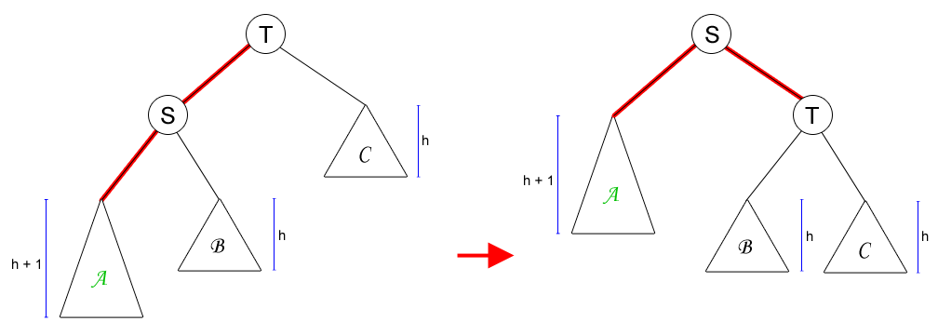
AVL Operations & Rebalancing
Operation INSERTION
Single Rotation to Fix Case 1 (LL Rotation)
The new key is located at sub tree A.

Slide 15
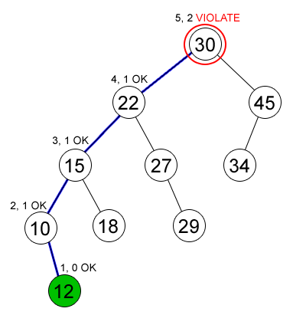
AVL Operations & Rebalancing
Operation INSERTION
Example on Single Rotation
Node (12) is inserted in an AVL Tree and causing node (30) to violate the AVL property (Case 1)

Slide 16
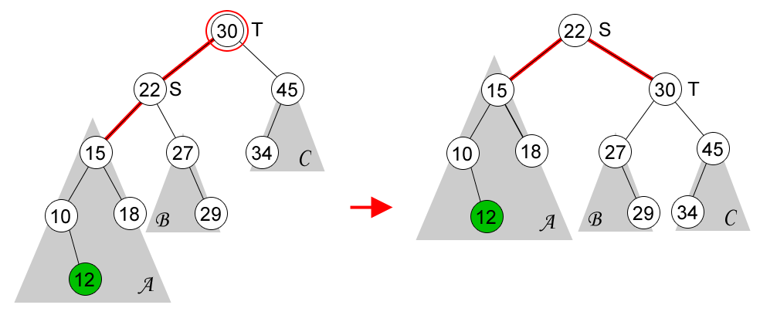
AVL Operations & Rebalancing
Operation INSERTION
Example on Single Rotation

Slide 17
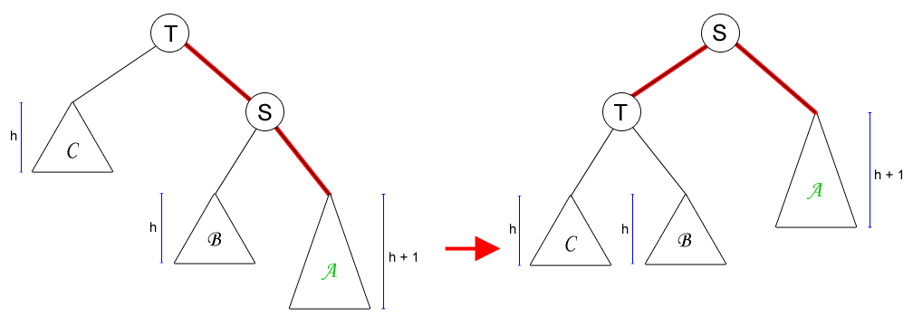
AVL Operations & Rebalancing
Operation INSERTION
Single Rotation to Fix Case 2 (RR Rotation)
Case 2 is mirror symmetry to Case 1.

Slide 18
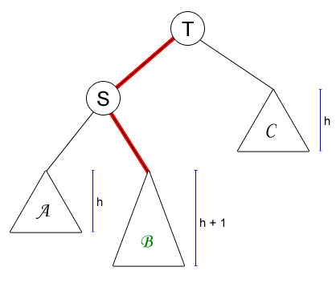
AVL Operations & Rebalancing
Operation INSERTION
Single Rotation on Case 3 (or 4)
What will happen if we do single rotation on case 3 or 4?

Slide 19
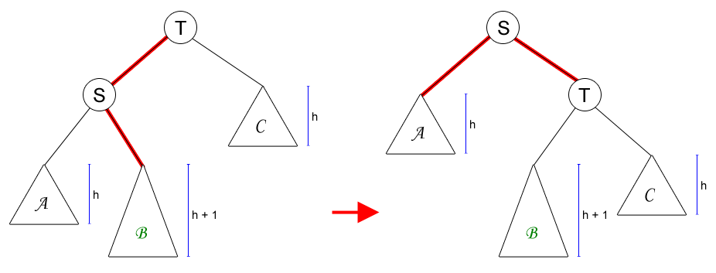
AVL Operations & Rebalancing
Operation INSERTION
Single Rotation on Case 3 (or 4)
The AVL property is violated at node S (the height of its left-sub tree is h and the height of its right-sub tree’s is h+2).
Single rotation is not solving our problem on Case 3 or 4.

Slide 20
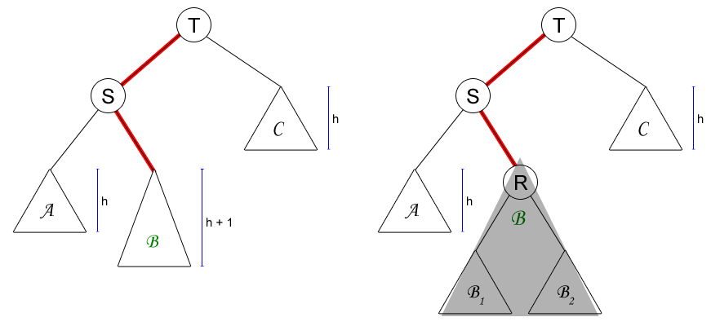
AVL Operations & Rebalancing
Operation INSERTION
Double Rotation to Fix Case 3 (LR Rotation)
A deeper look at sub tree B

Slide 21
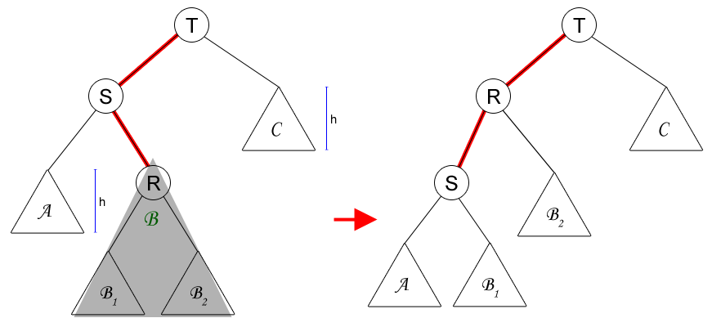
AVL Operations & Rebalancing
Operation INSERTION
Double Rotation to Fix Case 3 (LR Rotation)
First rotation: node R and S.

Slide 22
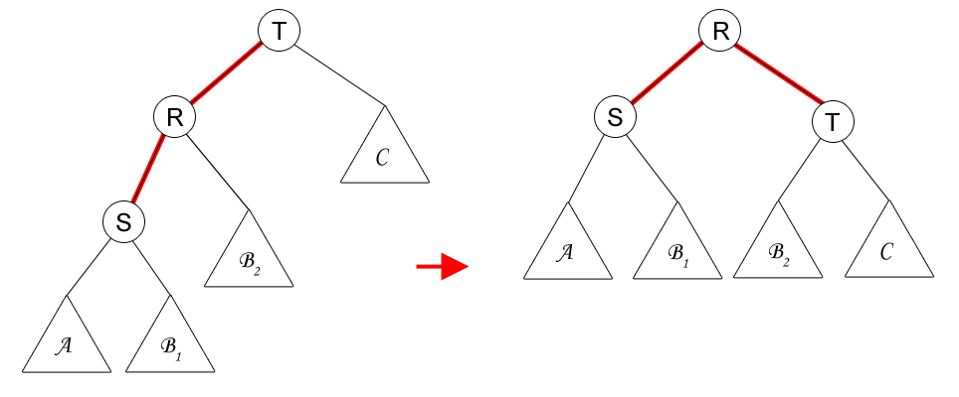
AVL Operations & Rebalancing
Operation INSERTION
Double Rotation to Fix Case 3 (LR Rotation)
Second rotation: node R and T.

Slide 23
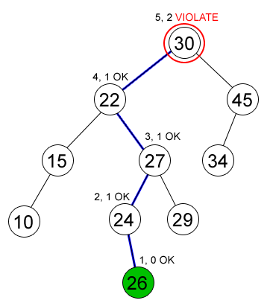
AVL Operations & Rebalancing
Operation INSERTION
Example on Single Rotation
Node (26) is inserted in an AVL Tree and causing node (30) to violate the AVL property (Case 3)

Slide 24
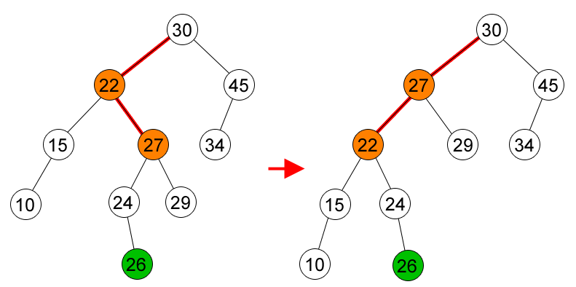
AVL Operations & Rebalancing
Operation INSERTION
Example on Double Rotation
First rotation, node (27) and node (22).

Slide 25
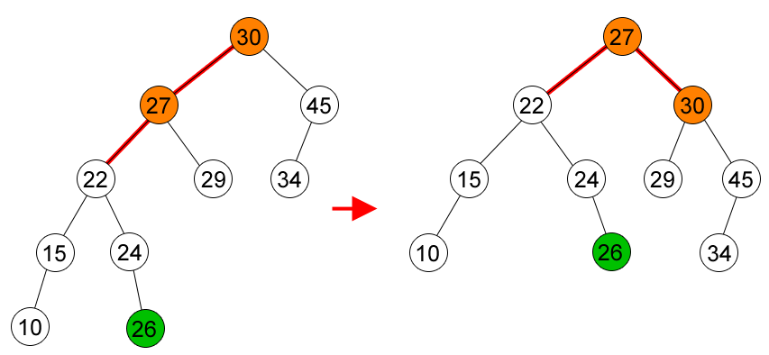
AVL Operations & Rebalancing
Operation INSERTION
Example on Double Rotation
Second rotation, node (27) and node (30).

Slide 26
AVL Operations & Rebalancing
OPERATION DELETION
Delete the node as in ordinary Binary Search Tree.
The deleted node will be a leaf or a node with one child.
Trace the path from the (parent of) deleted leaf towards the root. For each node P encountered, check if height of left(P) and right(P) differ by at most 1.
If Yes, proceed to parent(P).
If No, fix sub tree P either by single rotation or double rotation (as in insertion).
After we perform rotation at P, we may have to perform a rotation at some ancestor of P. Thus, we must continue to trace the path until we reach the root.

Slide 27
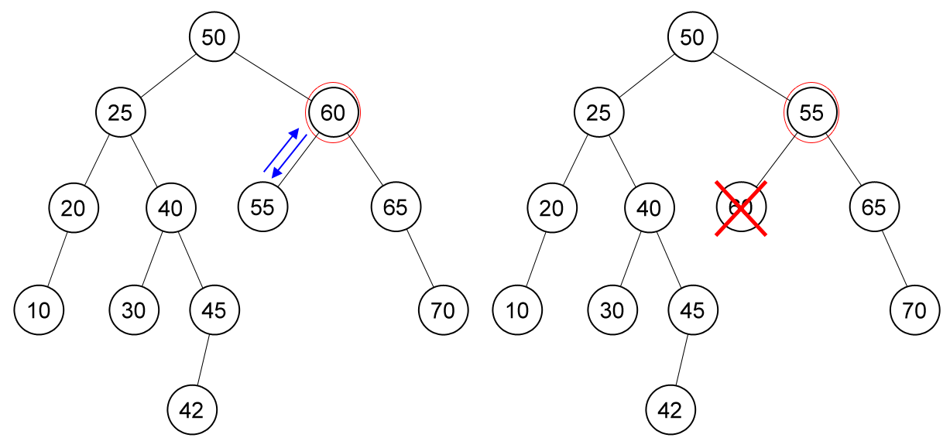
AVL Operations & Rebalancing
OPERATION DELETION
Delete node (60), node (55) is unbalanced.

Slide 28
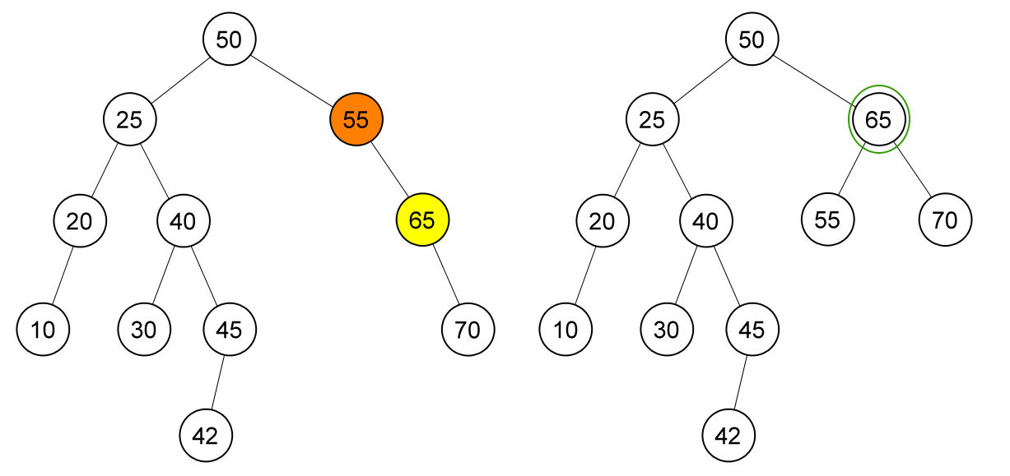
AVL Operations & Rebalancing
OPERATION DELETION
Single rotation on node (55)

Slide 29
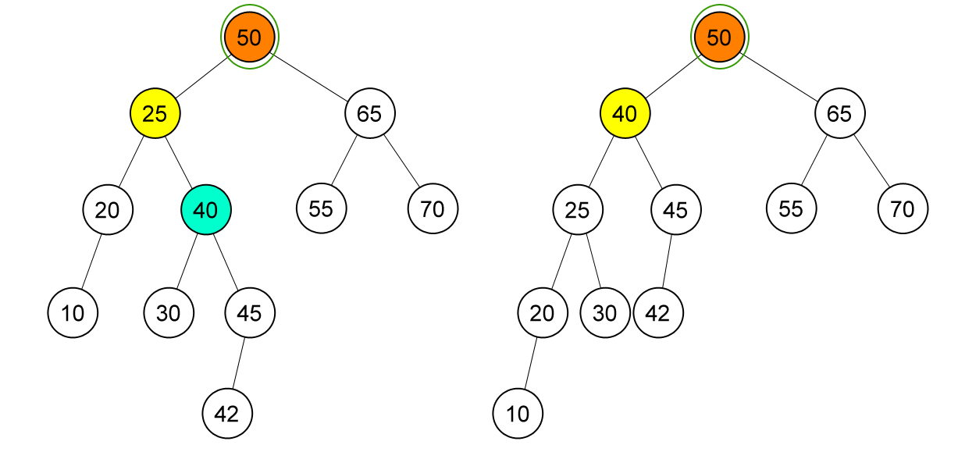
AVL Operations & Rebalancing
OPERATION DELETION
Node (50) is unbalanced, double rotation on node (50)

Slide 30
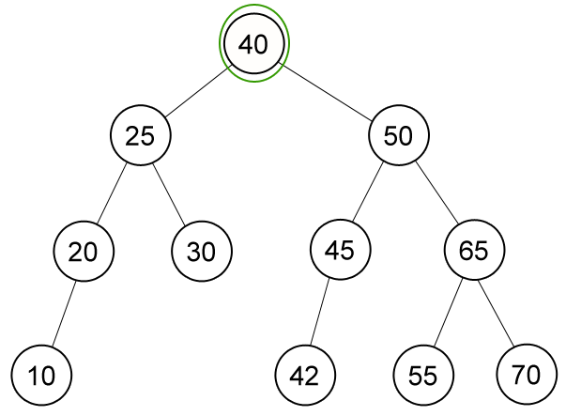
AVL Operations & Rebalancing
OPERATION DELETION
AVL Tree after deletion of node (60)

Slide 31
EXERCISE
Use the AVL tree concept with the following data “SOFTWARE”
Next please delete data “W” and “O”

Slide 32
References
S. Sridhar. 2015. Design and Analysis of Algorithms. Oxford University Press. New Delhi. ISBN: 9780198093695. Chapter 6
Reema Thareja. 2014. Data structures using C. Oxford University Press. New Delhi. ISBN:9780198099307. Chapter 10
Introduction to AVL Tree, https://visualgo.net/bn/bst?slide=13-1
AVL Tree, https://visualgo.net/bn/bst?slide=14
AVL Tree, https://www.programiz.com/dsa/avl-tree

